Slide 1
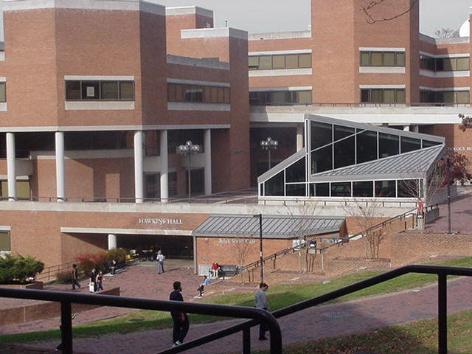
Pre-Application Meeting 1.Integrated Elementary Education/ Special Education EESE 2.Integrated Early Childhood/Special Education ECSE 3.Special Education Single Certification Majors – Secondary and Elementary/Middle http://www.youtube.com/watch?v=2XsaK3pWyII
Oct. 10/ 11, 2016
Mr. Charles Meyer
Ms. Elizabeth Radebaugh
Ms. Michelle Pasko
Dr. Patricia Rice-Doran

Slide 2
Welcome and Agenda
Welcome!
Please SIGN IN.
Agenda:
Programs
Application requirements and timelines
Professional dispositions and other info

Slide 3
Programs Available
Early Childhood/Special Education ECSE (preschool-gr. 3;birth-gr.3)
Elementary Ed/Special Education EESE ( gr.1-6;gr. 1-8)
Special Education- Elementary/Middle (gr. 1 – 8)
Special Education – Secondary/Adult (gr. 6 – 12/adult)
English Track
Math Track –Middle School Concentration
Math Track- High School Concentration
Middle School general Science Track
Social Studies Track.
Please note each program application is a different color.
Make sure your PeopleSoft record reflects your intended major. If not, please change in PeopleSoft.

Slide 4
Application Requirements
APPLICATIONS DUE DEC. 20, 2016
Have Criminal Disclosure statement notarized by Mrs. March- room 307.
GPA: 2.75 or better
C or better in ENGL 102 and all pre-req courses
60 credits completed or in progress (must include pre-reqs)
Scores on the Praxis I, Praxis Core, SAT or ACT at or above the passing level of standards established by the Maryland State Dept of Ed
Degree plan (see templates on website)
One page double spaced essay explaining your reasons for entering the teaching profession.

Slide 5
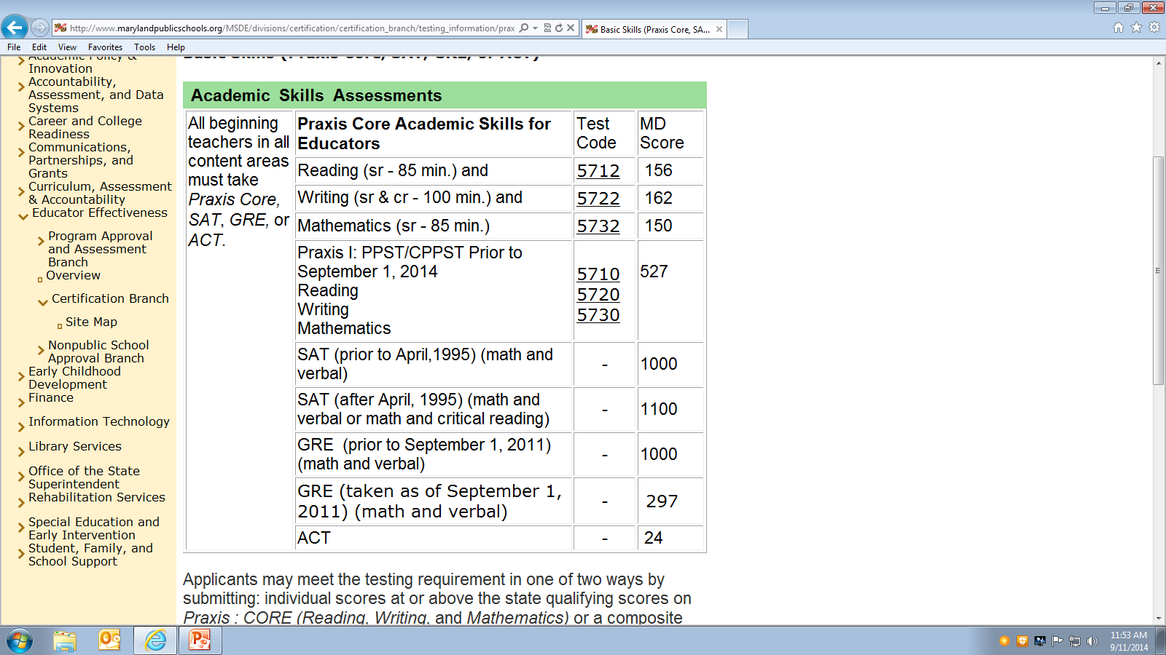
Take or Provide Passing Scores from one of the Tests Listed below

Slide 6
Tests needed for Acceptance
Make sure you keep a copy of your scores. You will need them for your application and for future employment as a teacher.
Do not depend on ETS to send the scores. Provide a copy yourself to the department.
If you do not print out scores while they are posted,ETS charges you $30 to get them later.
You should be able to print out SAT and ACT scores from their web sites.

Slide 7
Praxis Core Help
There are sample items for each test on the ETS website.
Amazon.com already has several Praxis Core study guides listed.
You must have the passing score on each section of Praxis Core- there is no composite score.

Slide 8
Applications are due to Psychology 307 by 4pm on December 20, 2016.
Fill in application completely
Include:
Criminal disclosure form
Unofficial transcript (if courses you need have not posted to your transcript you must submit an official transcript from the other school) with FALL 2016 grades
Updated checklist
Most recent advising data sheet AND four-year degree plan
Copy of Praxis, SAT, or ACT scores.
One-page essay
Letter describing your plan if you need to finish pre-requisites in summer.
Clip or staple all items together.

Slide 9
Four Year Degree Plan
Required by Maryland law—upper-level students must have one on file.
Templates and directions available on Special Education Department website
Fill in template with classes you have taken thus far. Template is pre-filled with your major coursework, which you’ll begin after program admittance.

Slide 10
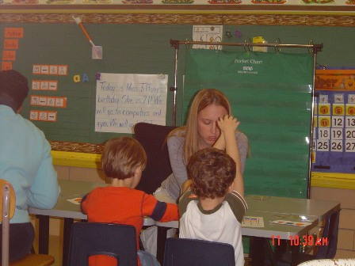
Deadlines
If you have not passed Praxis Core or one of the other accepted tests, hand in the scores you have so far to show your efforts. You cannot be admitted until you pass, but you will be placed on the waiting list.

Slide 11
GPA
You must have a minimum GPA of 2.75 in the prerequisite courses related to your major to be admitted to any TU education program. Admission is limited by space, so that some students who meet all requirements may not be admitted.
If your overall GPA is below 2.75, your advisor MAY be able to to calculate the GPA for just the major prerequisites.
You may not have a D in any prerequisite courses.
If you believe you can bring your GPA up to 2.75 by the end of Spring 2017, write a letter explaining your plan. However if your GPA is not a 2.75 at the end of fall semester, your chances of admission to any education program are extremely limited.
Once you are in the program, you must have at least a 3.0 each semester and no grade below a C.

Slide 12
Short of Credits?
If you will not have 60 credits by the end of spring 2017, but are willing to attend summer school, submit a letter explaining your plan.

Slide 13
For the Record – Once you are accepted
Be flexible. You are guaranteed your courses but not a specific schedule or days off in a week.
Your schedule cannot be adjusted around work or carpool
Arrive on time to schools and be professional.
Remember a course in which you receive a “D” will have to be retaken before you can continue.
You must maintain a 3.0 in the major.

Slide 14
Professional Manners and Matters
Demonstrate Essential Dispositions
Commitment to professional practice
Caring for the success and well-being of all students
Collaborate with colleagues and stakeholders
Dress appropriately at all times when in schools.
Demonstrate professional behavior by ethical, moral, collegial and honest interactions with others
Maintain confidentiality
Support others at all times

Slide 15
Professional Manners and Matters
Before you choose any education major remember the criminal background check before you student teach is extensive and intensive.
School systems control who can student teach in their schools
If you have ever had contact with the courts, you may want to consult Mr. Caldwell in CPP
to determine your risk of being barred from student teaching.

Slide 16
Other Opportunities
Students interested in becoming student members of Council for Exceptional Children can email Dr. Kandace Hoppin (khoppin@towson.edu)lrichman@towson.edu

Slide 17
Important Info
The FALL of your senior (pre-professional) year, you will need to return to school earlier than TU’s start date—your professional internship WILL begin the third week of August and absences are not excused.
Plan vacation, trips, work, etc. AROUND this pre-professional commitment.

Slide 18
QUESTIONS?

